Slide 1
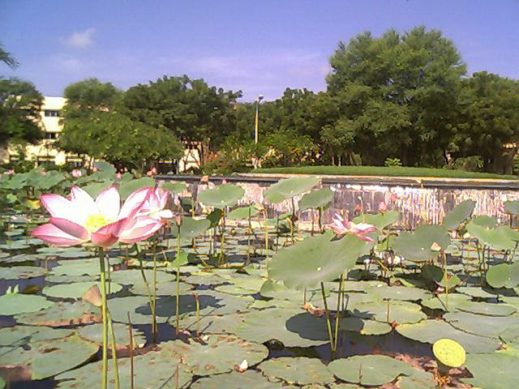

Slide 2

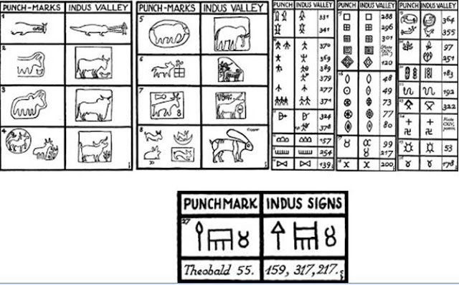

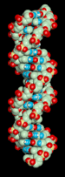

SC 402 Introduction to Cryptography
http://ccom.uprrp.edu/~labemmy/?page_id=32
Prof. Manish K. Gupta

Slide 3
Tentative Topics
Historical Introduction and Motivation of Cryptography, Basic review of elementary number theory and algebra, Overview of cryptography (AC Ch 2, KL Ch 2)
Basic Symmetric-key encryption:
Introduction to cipher, Basic symmetric-key encryption: One time pad and stream ciphers (AC Ch 3, KL 3.2.1-3.4.2) Block ciphers (Feistel networks and iterated Even-Mansour ciphers, case studies AES and 3DES (AC Ch. 4.1, 4.2; KL Ch. 6.1-6.2), Uses of Block ciphers (Pseudo Random Permutations (PRP); Pseudo Random Functions (PRF); security against chosen plaintext attacks (CPA); Modes of operation: CBC and counter mode (AC. Ch 4.4, 5; KL Ch 3.5)
Message Integrity:
Message integrity: definition and applications (CBC-MAC and PMAC), (AC Ch 6; KL Ch 4.1-4.3), collision resistant hashing (Merkle-Damgard and Davies-Meyer. MACs from collision resistance. Case studies: SHA and HMAC (AC Ch. 8.1-8.9; KL Ch 5.1-5.3) Authenticated encryption: secure again active attacks: Intro to session setup using a key distribution center (KDC).( AC Ch. 9; KL Ch 4.5)
Public key cryptography:
Cryptography using arithmetic modulo primes: vanilla key exchange (Diffie-Hellman); the CDH and discrete-log assumptions (AC Ch. 10; KL Ch 9, 11.4.1), public key encryption: semantically secure ElGamal encryption; CCA security (AC Ch. 11; KL Ch 9, 11.4.1), arithmetic modulo composites: RSA and Rabin functions. how to encrypt with trapdoor permutations (AC Ch. 10.2, 10.3; KL Ch. 11.5)
Digital Signatures:
Digital signatures: definitions and applications: how to sign using RSA (AC CH 13; L CH 12.1 12.4), more signature schemes and applications (hash-based signatures, certificates, certificate transparency, certificate revocation. (AC Ch. 13.8, Ch. 14; KL Ch 12.5-12.8)
Protocols:
Identification protocols: Password protocols, salts; one-time passwords (S/Key and SecurID); challenge response authentication. (AC Ch. 18), Authenticated key exchange and SSL/TLS session setup (AC Ch. 21), Zero knowledge protocols (AC Ch. 19)
Source (Don Boneh): https://crypto.stanford.edu/~dabo/courses/cs255_winter21/syllabus.html

Slide 4


Overview
Classical Cryptography
Private Key (Symmetric) Cryptography
Public Key (Asymmetric) Cryptography
Protocols

Slide 5
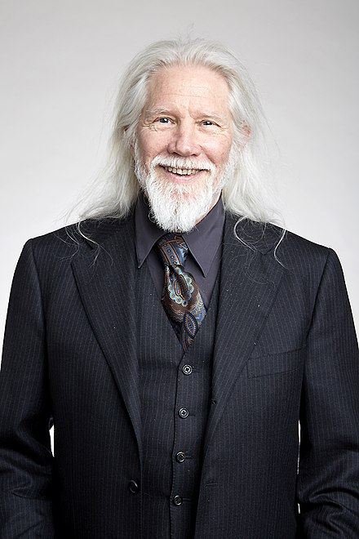
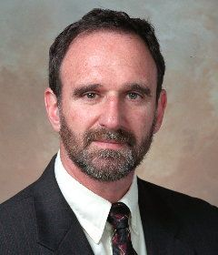
1976 (Public Key Exchange)
Remarkable Discovery
Whitfield Diffie
Martin Hellman

Slide 6
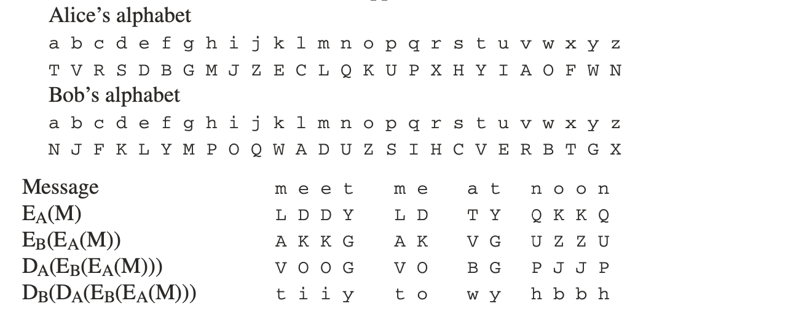
The Key Exchange Problem
The substitution does not commute
They needed a function (cipher algo) that commute
Discrete Log Problem

Slide 7
The Key Exchange Problem
They needed a function (cipher algo) that commute
Discrete Log Problem
Given
What is a ?
Alice and Bob decide g and p and exchange them over insecure channel
Alice chooses a (secret number)
Bob chooses b (secret number)
Alice computes:
Bob computes:
They exchange these over insecure channel
Alice computes now:
Bob Computes:

Slide 8
The Key Exchange Problem
They needed a function (cipher algo) that commute
Discrete Log Problem
Given
What is a ?
Alice and Bob decide g and p and exchange them over insecure channel
Alice chooses a (secret number)
Bob chooses b (secret number)
=Common Secrete Key
Drawback: Several Key Exchanges

Slide 9
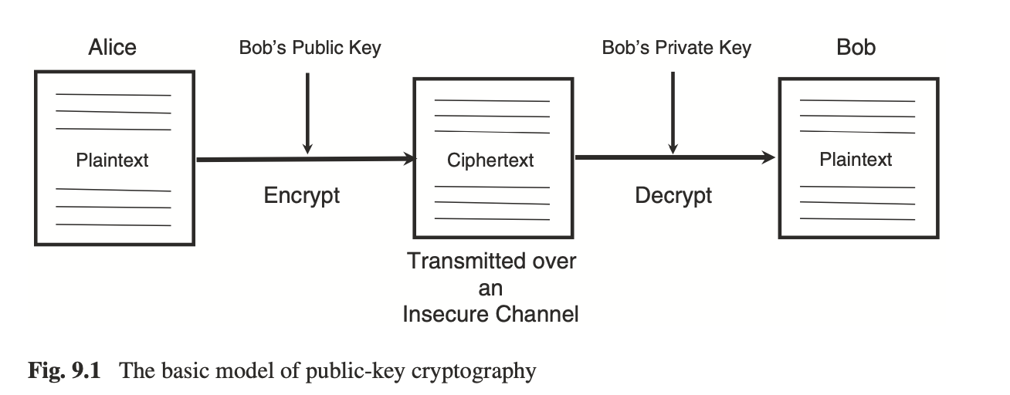
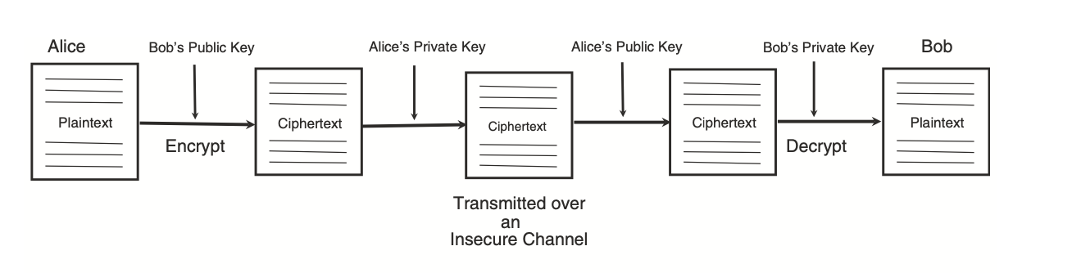
Public Key Cryptography Appears
Pair of public and private key
How to communicate without exchanging too many messages?
Birth of Asymmetric Key Cryptography
Authentication is a problem too
:Digital Signature

Slide 10
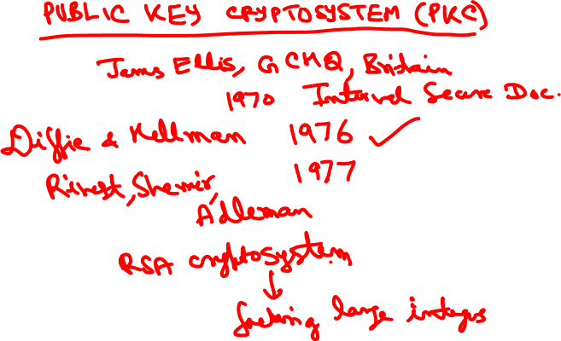

Slide 11
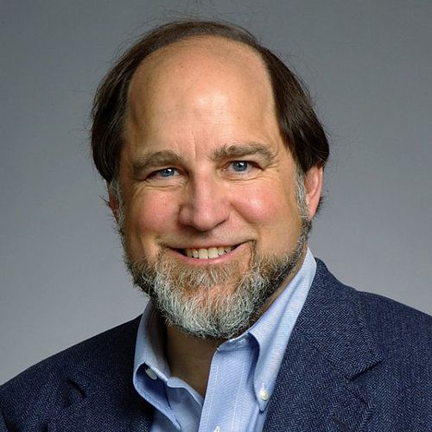
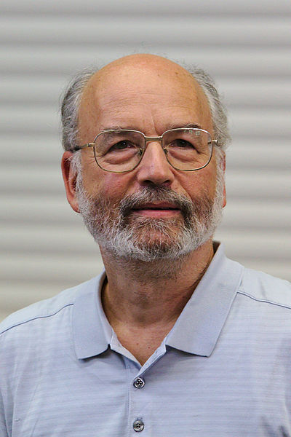
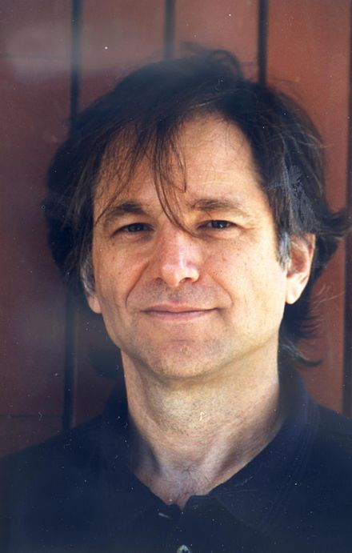

1977 (RSA Cryptosystem)
Ron Rivest
Adi Shamir
Leonard Adlemann
Backbone of current Security on Internet
By RSA Security - RSA Security, Public Domain, https://en.wikipedia.org/w/index.php?curid=56108016

Slide 12
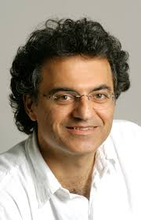
How much difficult it is to factor?
Umesh Vazirani (1994) for factoring
a 2000 digit number:
“It's not just a case that all the computers in the world today would be unable to factor that number. It's really much more dramatic…. Even if you imagine that every particle in the Universe was a (classical) computer and was computing at full speed for the entire life of the Universe, that would be insufficient to factor that number”.

Slide 13
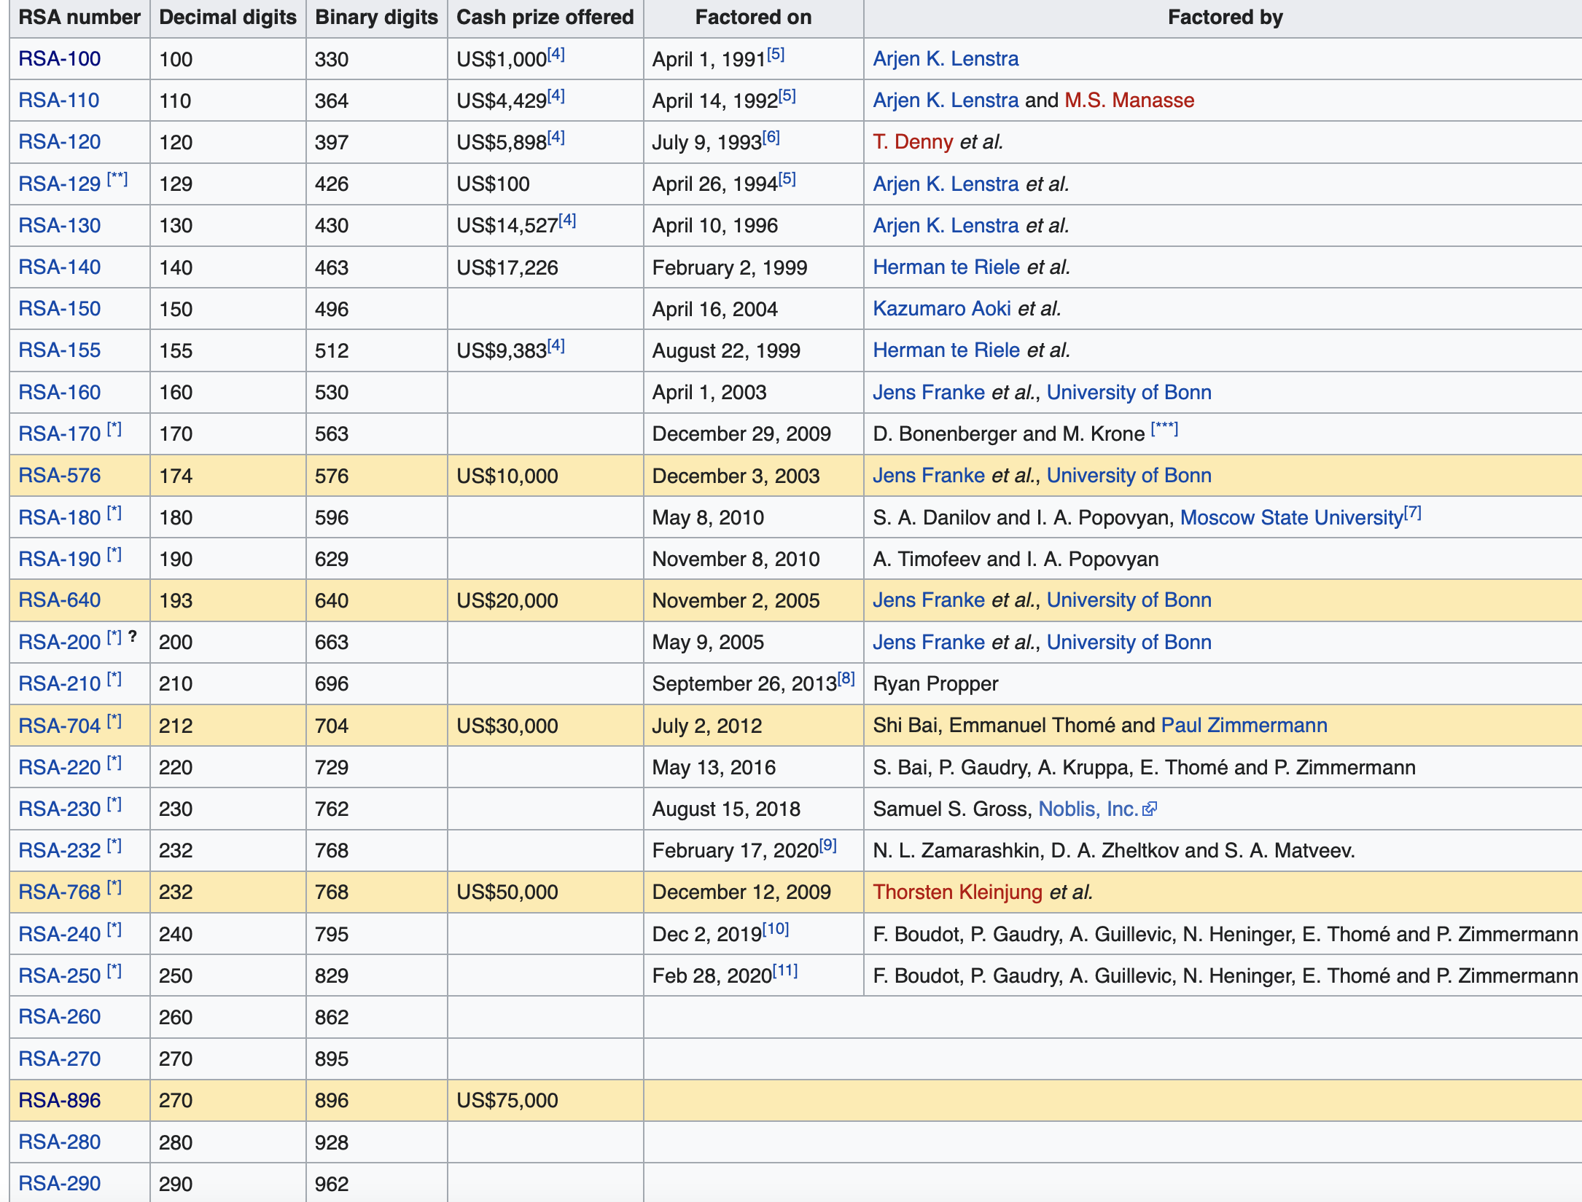
RSA Numbers

Slide 14
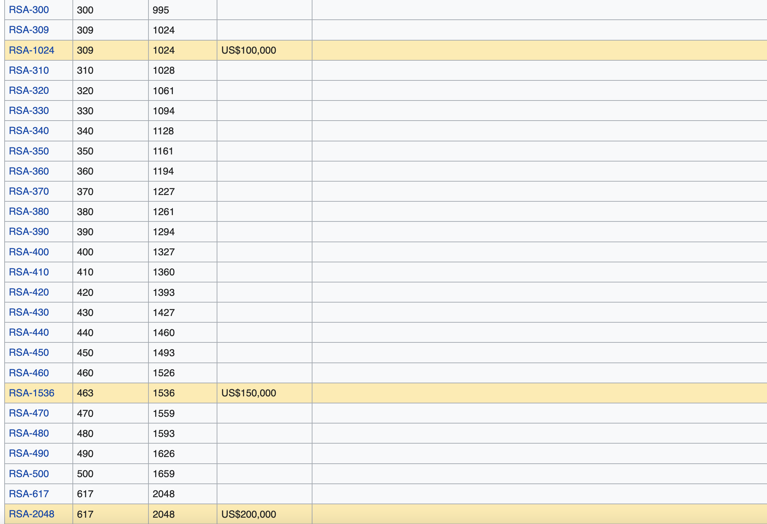
RSA Numbers

Slide 15
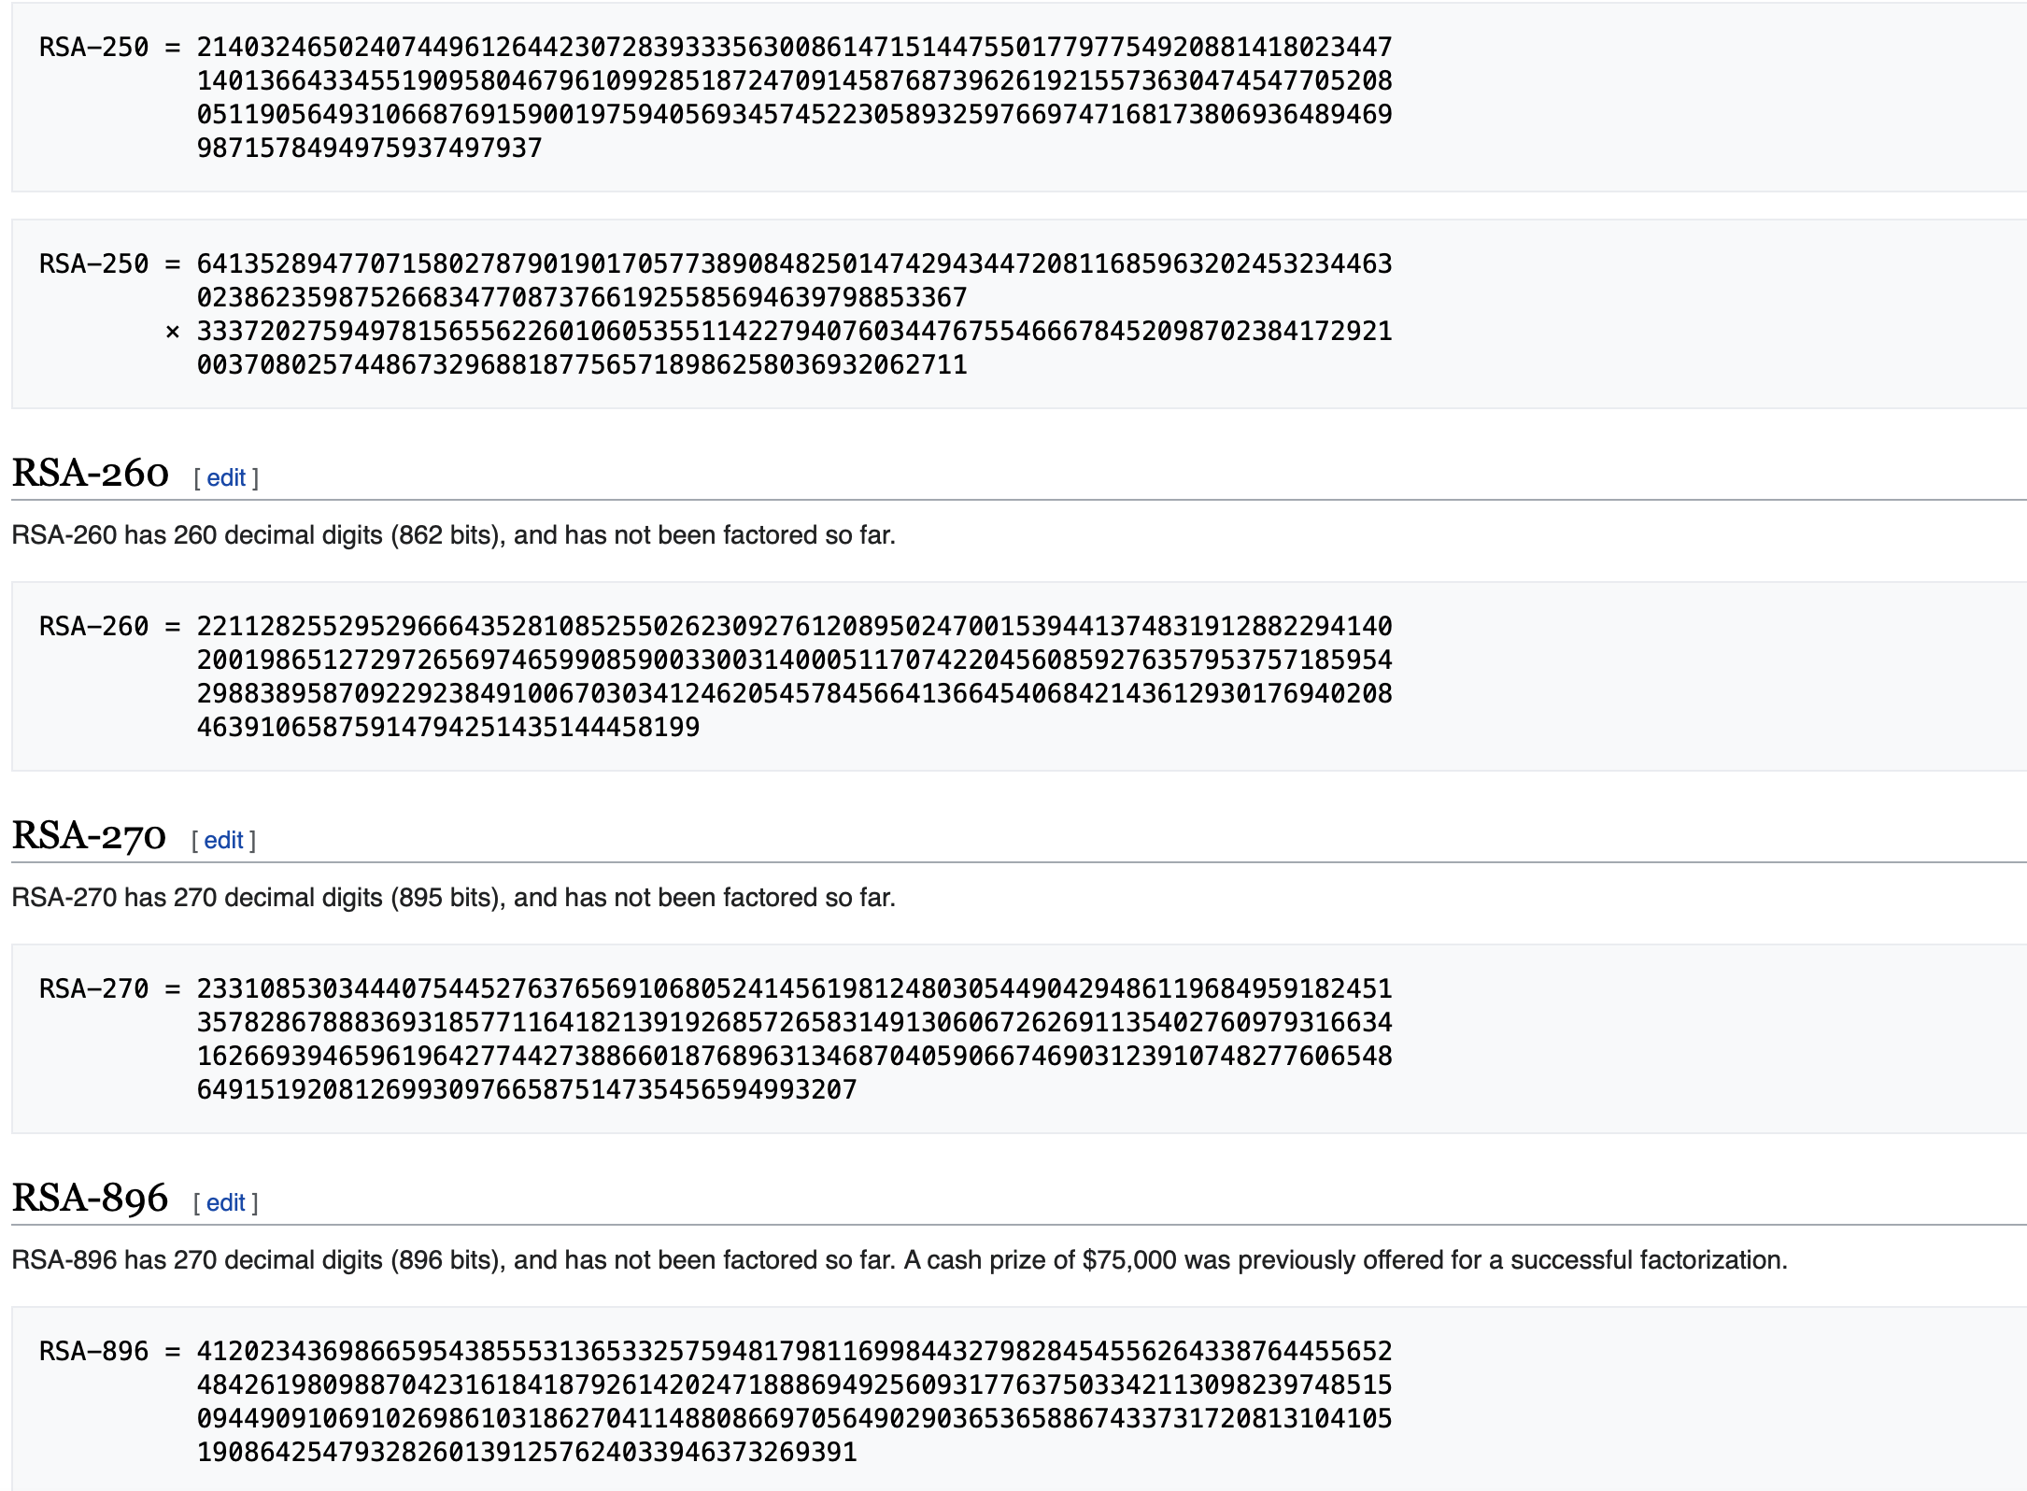
RSA Numbers

Slide 16
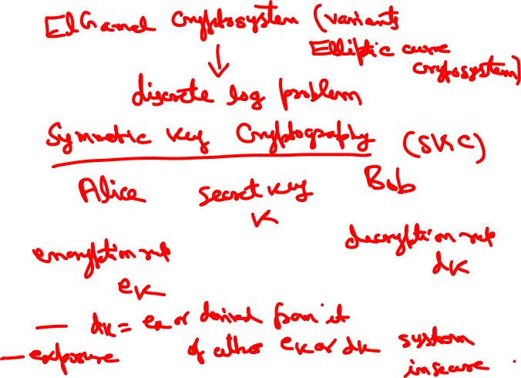

Slide 17
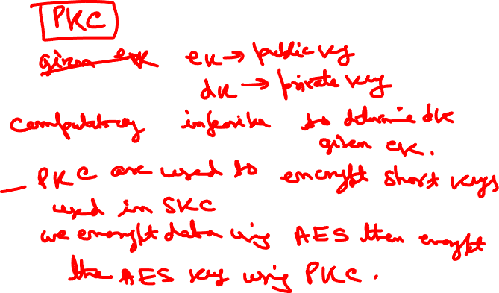

Slide 18
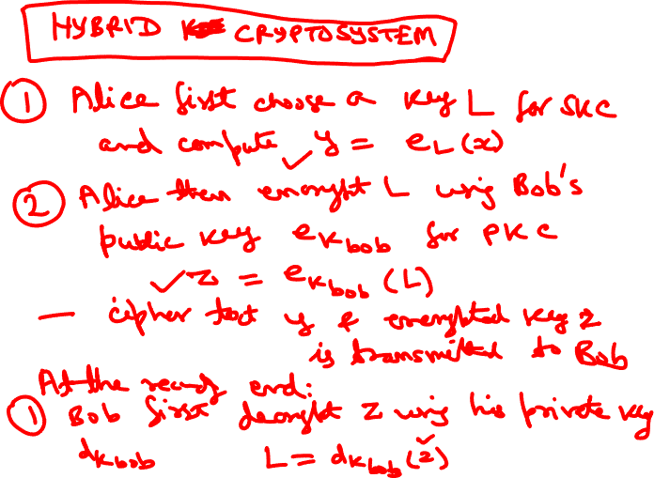

Slide 19
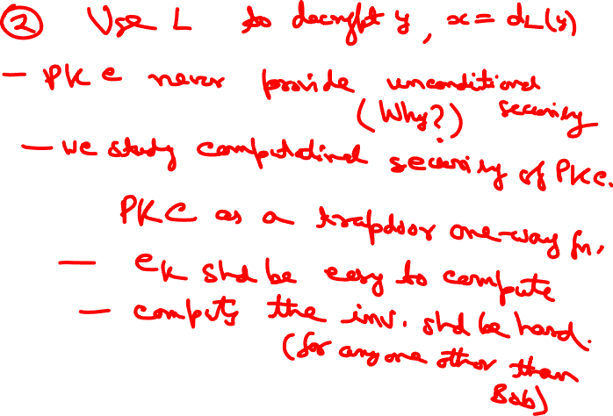

Slide 20
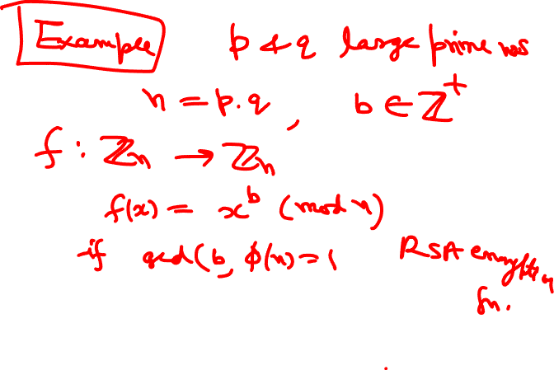

Slide 21
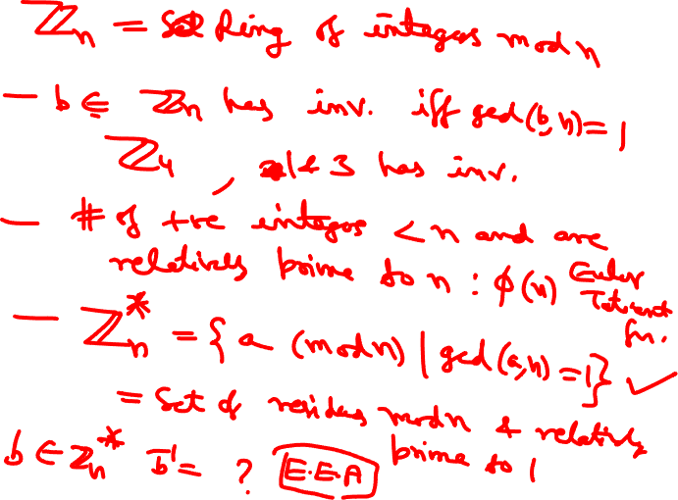

Slide 22
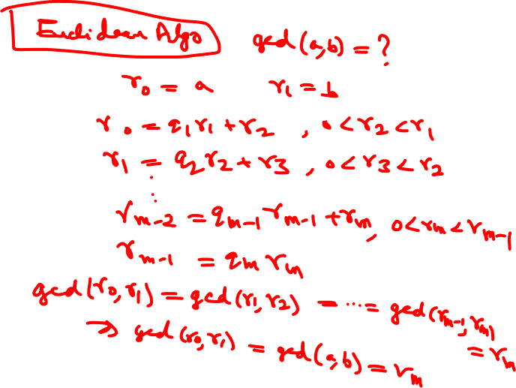

Slide 23
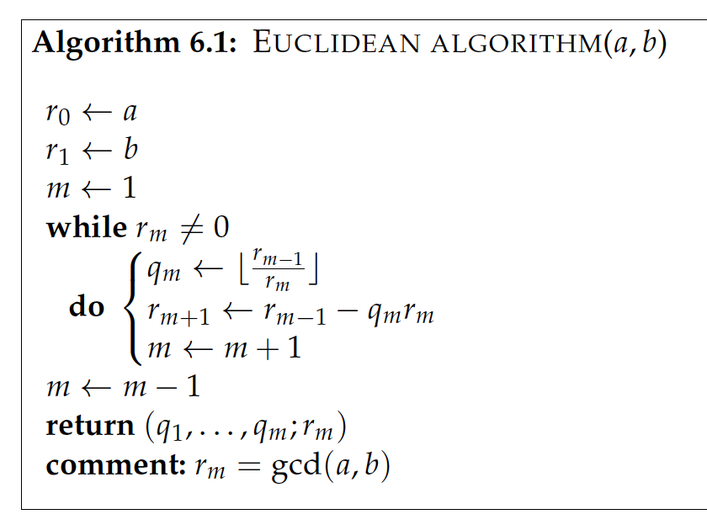
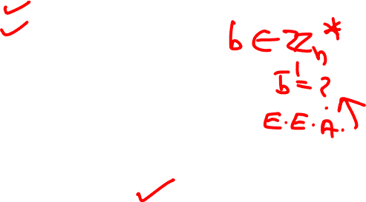

Slide 24
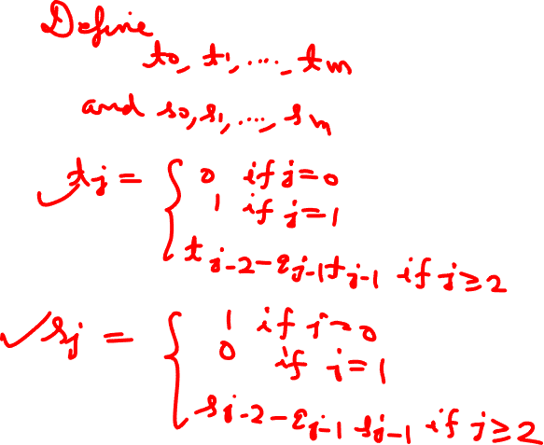

Slide 25
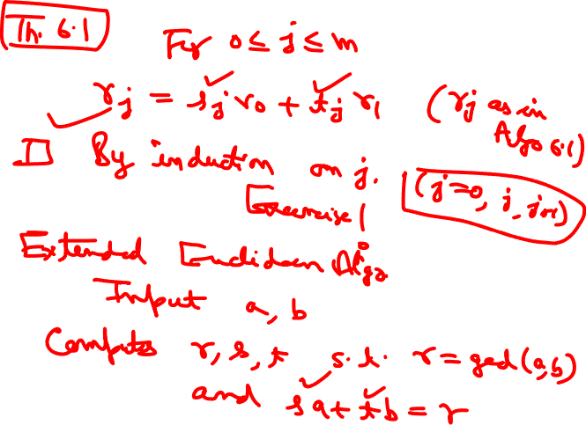

Slide 26
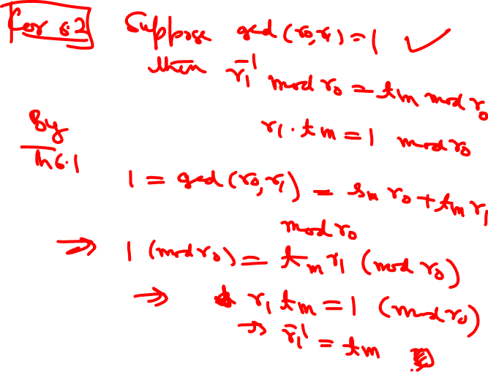

Slide 27
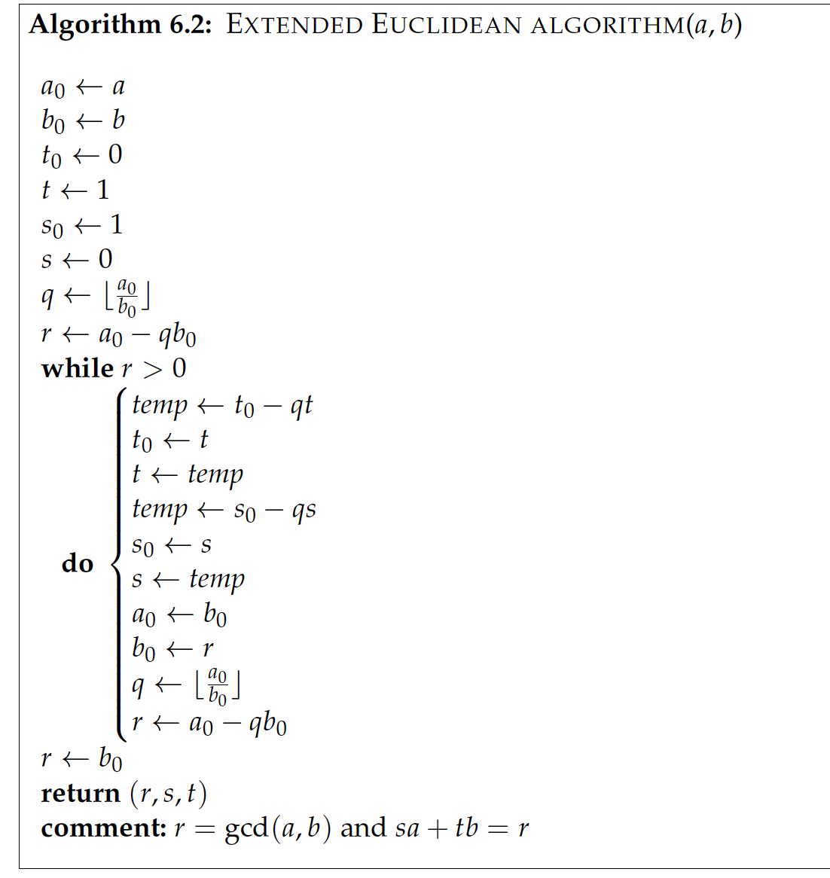
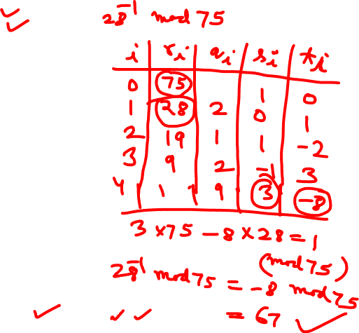

Slide 28
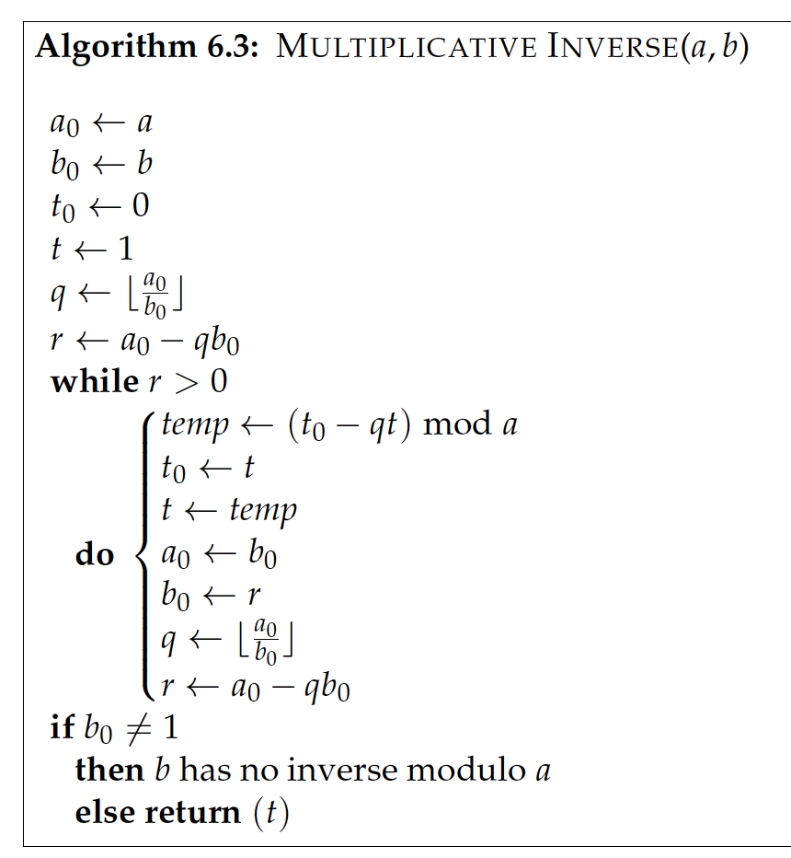


Slide 29
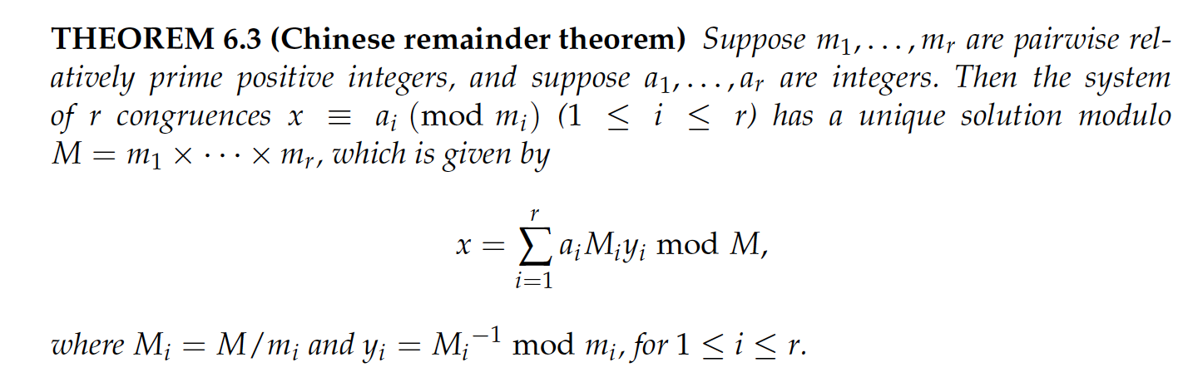
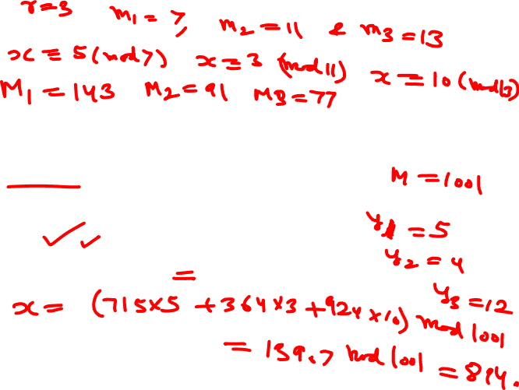

Slide 30
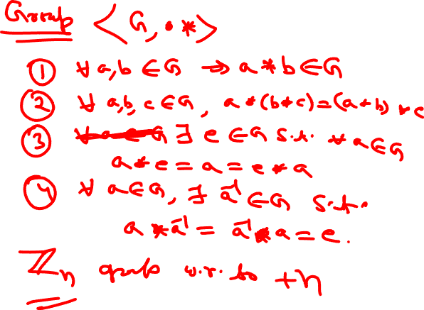

Slide 31
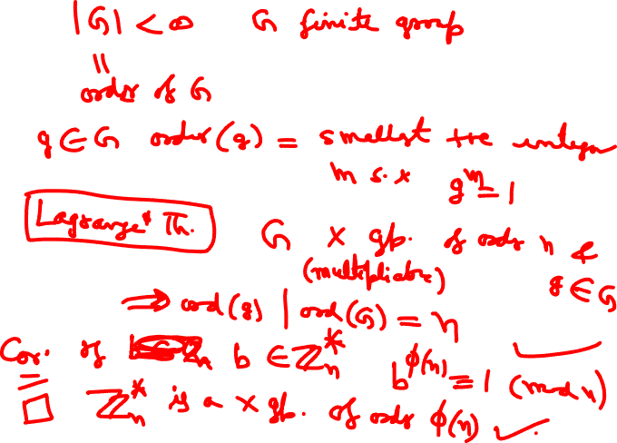

Slide 32
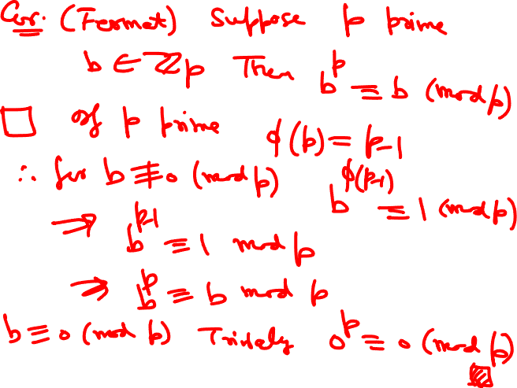

Slide 33
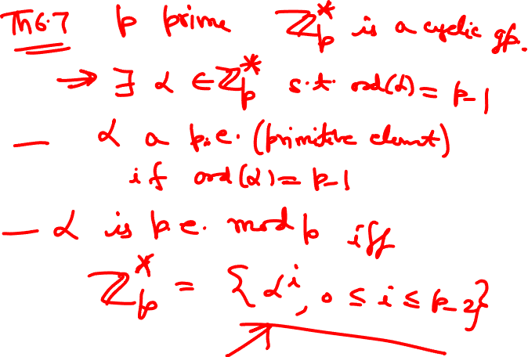

Slide 34
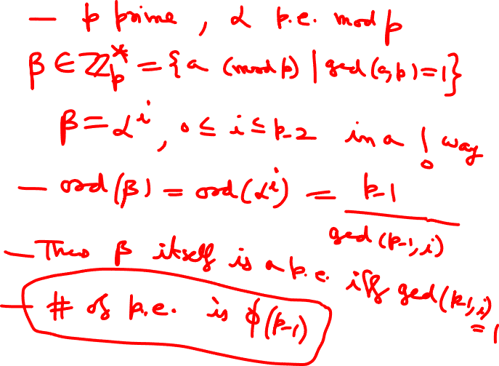

Slide 35
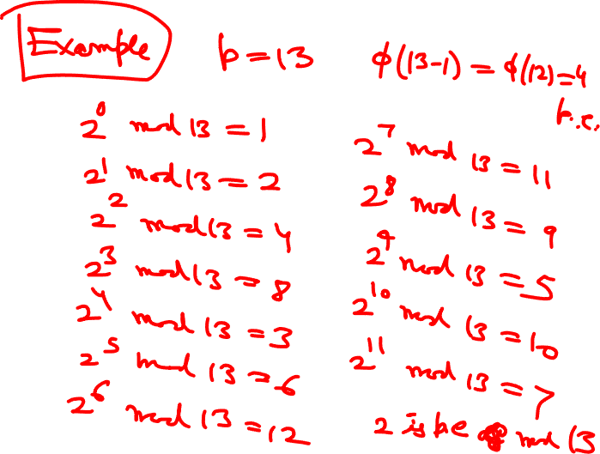

Slide 36
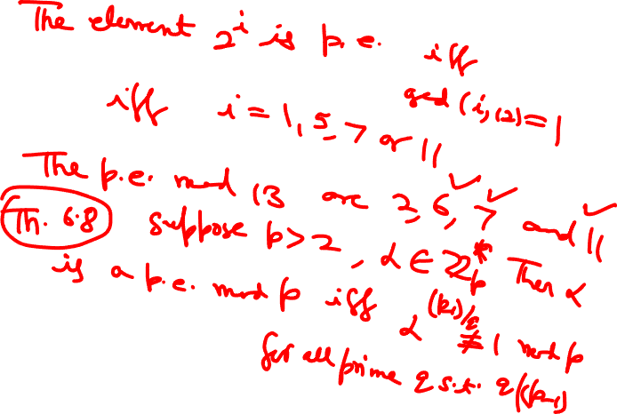

Slide 37
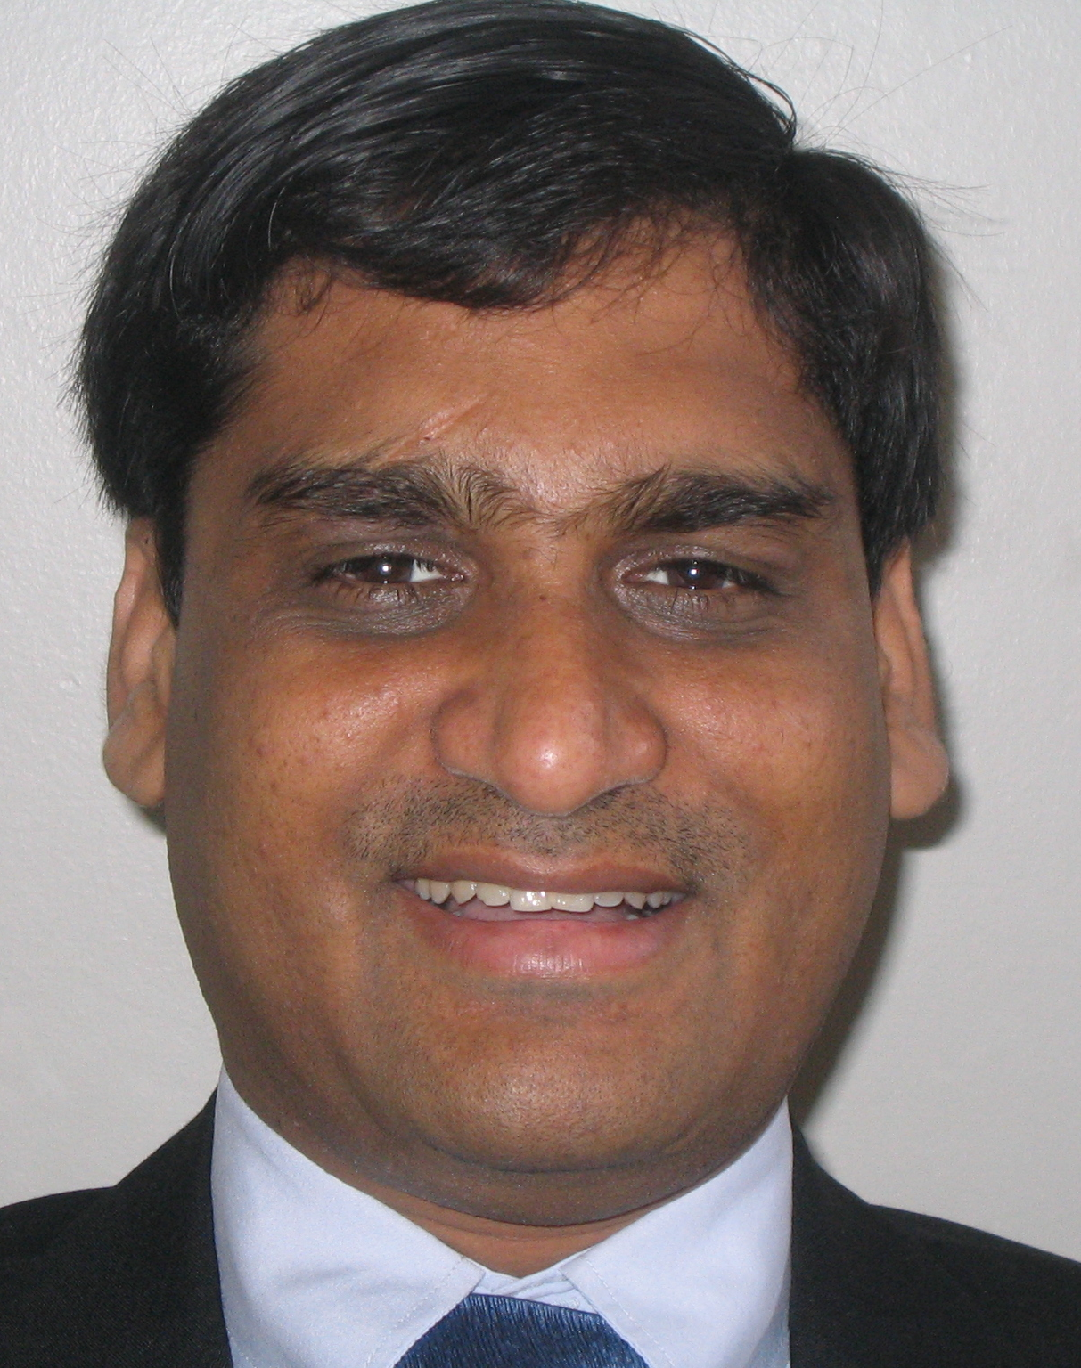
Profile of Manish K Gupta, PhD IIT Kanpur
International and interdisciplinary working experience of more than 28 years in 8 countries such as USA, Canada, Germany, Singapore, New Zealand, South Korea, Saudi Arabia and India.
Generated funding worth more than INR 30 million (Rs 3 crore)
Founder of DA-IICT Centre for Entrepreneurship and Incubation (a section 8 not for profit company) which incubated 19 start-ups/companies from 2007
Founder of Guptalab which produced well known 11 softwares in DNA nanotechnology
DNA storage project shortlisted as top 5 innovation for Prime Minister (India and Israel) demo at India Israel Innovation Initiative, Jan 2018, iCreate Campus, Deo Dholera, Gujarat, India
Featured Reviewer ACM Computing Review February 2016 Issue
IEEE Computer Society Distinguished Visitor 2022-2024
Invited for Microsoft Research Faculty Summit, Redmond, USA, 2009
Senior Member of IEEE
Served/Serve on numerous government committees (total 37) on start-up/innovation/technical and policy making in India
Professor at Dhirubhai Ambani Institute of Information and Communication Technology
Manpower supervised, mentored and coached : 3 PhDs, 51 undergraduate research projects and more than 200 summer interns
Publications: Published more than 37 papers in international journals and conferences, 27 book/article reviews in ACM computing reviews and 95 article reviews in AMS (Mathematical Reviews), H-index 14
Editorial Board: Total 3 journals: Journal of Applied Mathematics and Computation, Springer, AIMS Electronics and Electrical Engineering, AIMS Press, IEEE Journal on Selected Areas in Communications, Special Issue on Emerging Technologies in Communications (Area: Nanoscale and Molecular Networking), 2013 (Guest Associate Editor)
Research Areas: Mathematics and its elegant applications in emerging technologies: DNA and bacterial data storage, DNA computing, chemical computing, coding theory, quantum computing, cryptography, quantum machine learning, DNA nanotechnology, quantum error correction, bioinformatics
Teaching Areas: Taught a total of 51 courses, 5103 students, 20 different types of courses in Mathematics, ICT, Computer Science, Electrical Engineering and Biology at various international universities
www.mankg.com www.guptalab.org
Email: mankg@guptalab.org
YouTube:https://youtube.com/c/ManishGuptamankg

Slide 38

Any Questions ?
“Mathematics is the queen of the sciences and number theory is the queen of mathematics.”
C.F. Gauss

